Slide 1
CIND119 Final Project: Bank Marketing Dataset
February 27, 2020
Miguel Villamayor, Huzaifa Gul, Tanya Sheryl, Zafrina Somani, Kabriya Thavaratnam

Slide 2
Introduction
Bank Marketing Dataset was used
Dataset collected from a Portuguese bank
Problem: Devise a strategy to analyze which type of customers would subscribe to a long-term deposit account
Solution: Three algorithms were used to determine the most accurate one, which can determine which customers are more likely to subscribe to this account
Decision tree, Naive Bayes and Random Forest
The dataset was a supervised dataset
Notes:
Zafrina

Slide 3
Attributes
Age
Job
Marital
Education
Default
Balance
Housing
Loan
Contact
Day
Month
Duration
Campaign
Pdays
Previous
P Outcome
Class- Y/N
There are 17 attributes where the class attribute tells you if the client has actually subscribed to the account or not
There are 6 numeric attributes and the rest are qualitative/categorical
This is supervised data because the predicted output already exists as the class attribute
Notes:
tanya

Slide 4
Methods/Experiment
1) Data Preparation: Preprocessing
Determined max, min, mean, standard deviation, outliers, normality testing, class balancing and correlation
2) Predictive Modeling (Classification)
Used Decision tree, Naive Bayes and Random Forest
Cross-Validation vs. Percentage Split
3) Post- Predictive Analysis
K-Clustering & Apriori
Notes:
Miguel

Slide 5

Methods: Decision Tree, Naïve Bayes, Random Forest
Decision Tree:
classify data by comparing the attributes of the data set to predict a target variable
recursive process splits the data set into subsets based on an attribute value.
Naïve Bayes:
classification method based on Bayes’ Theorem
assumes that a particular feature in a class is independent of other features
Random Forest:
aggregates the votes from different decision trees to decide the final class
parameters used as input to the tree could be the total number of trees to be generated, minimum split and the split criteria
Notes:
Tanya

Slide 6
Data Split Type
10 Cross Fold Validation
A statistical technique for Machine Learning Model Evaluation where a value k=10 is commonly used to compare and select a model for a given predictive modeling problem and generally has a lower a bias than other methods.
Percentage Split
It split the data set into two parts, training and testing, perhaps two-thirds of it for training and one-third of it for testing. Both training and test sets are produced by independent sampling from an infinite population.
Notes:
huzaifa

Slide 7
Post Predictive Analysis
Apriori
An algorithm designed to be applied on a transaction dataset to discover patterns. It is a significant algorithm for mining frequent itemsets and association between various item sets.
K-Means Clustering
K-Mean is a clustering algorithm that seeks hidden patterns that potentially exist in the data set. Its purpose is to group data into distinct clusters whereby each cluster is similar as it can, yet different. It performs its task by calculating the squared distances between the inputs and the centroids and decides which cluster the input belongs to based on the shortest squared distance
Notes:
huzaifa

Slide 8
Results
Classification Method | Data Split | TP Rate | FP Rate | Precision | Recall | Accuracy
J48 Decision Tree | Cross Validation* | No – 0.93 | No – 0.32 | No – 0.92 | No – 0.93 | 88%
 |  | Yes – 0.67 | Yes – 0.07 | Yes – 0.72 | Yes – 0.68
 | Percentage Split** | No – 0.94 | No – 0.41 | No – 0.90 | No – 0.94 | 87%
 |  | Yes – 0.60 | Yes – 0.06 | Yes – 0.71 | Yes – 0.60
Naïve Bayes | Cross Validation* | No – 0.89 | No – 0.37 | No – 0.90 | No – 0.89 | 83%
 |  | Yes – 0.63 | Yes – 0.11 | Yes – 0.59 | Yes – 0.63
 | Percentage Split** | No – 0.90 | No - 0.39 | No – 0.90 | No – 0.90 | 84%
 |  | Yes – 0.61 | Yes – 0.11 | Yes – 0.60 | Yes – 0.61
Random Forest | Cross Validation* | No – 0.96 | No – 0.33 | No – 0.92 | No – 0.96 | 90%
 |  | Yes – 0.67 | Yes – 0.04 | Yes – 0.82 | Yes – 0.67
 | Percentage Split** | No – 0.97 | No – 0.40 | No – 0.90 | No – 0.97 | 89%
 |  | Yes – 0.60 | Yes – 0.04 | Yes – 0.82 | Yes - 0.60
Notes:
Zafrina

Slide 9
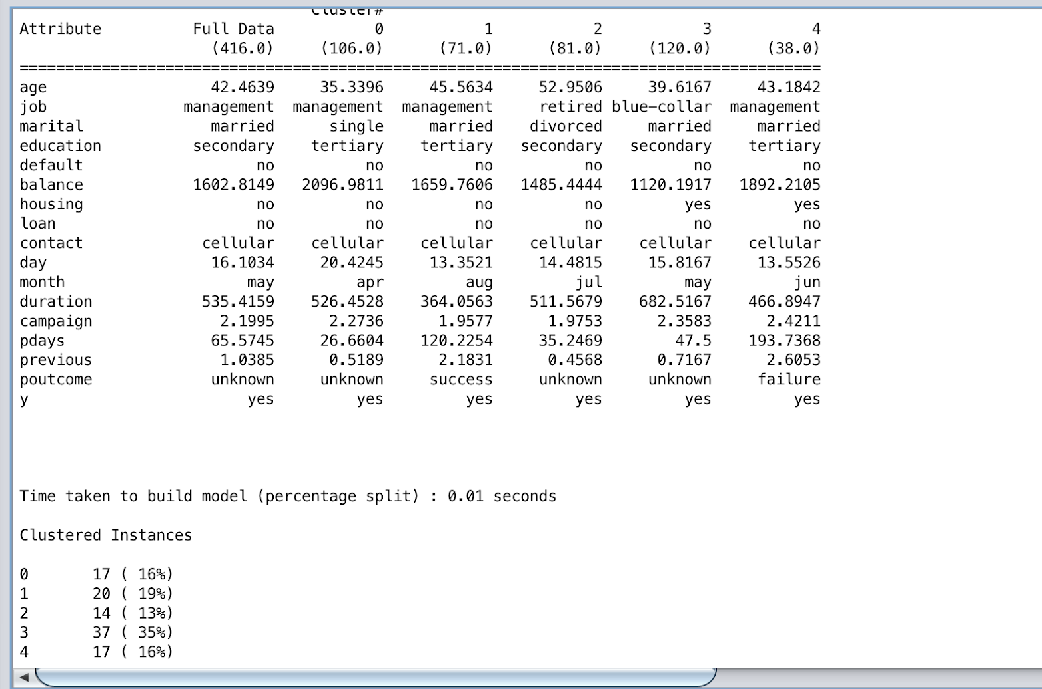
K-Clustering
Notes:
miguel

Slide 10
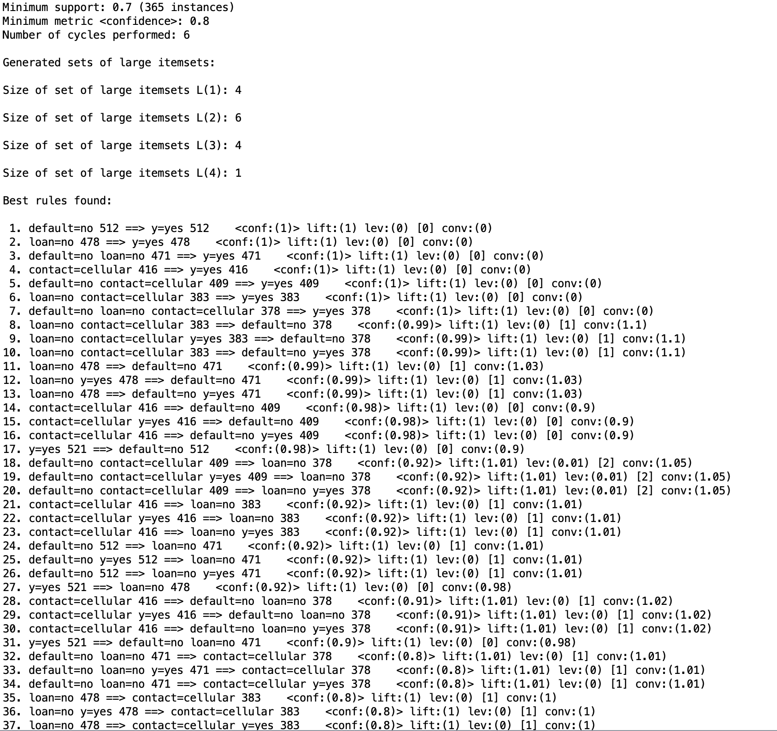
Apriori
Notes:
Kabriya
In our post predictive analysis the apriori algorithm was also performed. This is an algorithm for frequent itemset mining. It is basically used to mine frequent itemsets and relevant association rules.
In our analysis the minimum support threshold was set at 0.7. (anything below min support is not considered a freq itemset so we disregard it)
The top seven rules had a confidence of 100%. The first rule is that when the customer does not have a history of defaulting they are more likely to subscribe to a long-term deposit account. The second rule was if the customer did not have a loan they were also more likely to subscribe and if both conditions were also met they were also more likely to subscribe. This makes sense because customers who haven’t defaulted are more eligible to obtain a long-term deposit account whereas customers who have defaulted are probably not eligible and customers who don’t have a long are more likely to subscribe to this type of account.
Customer’s who’s contact method is primarily cellular was also determined to be one of the top rules for subscribing to an account with confidence level at 1, which essentially means that they probably have good credit to qualify for a long-term deposit account. Another top rule is if they haven’t defaulted and had no loan and main contact was cellular the confidence level was 1. The top seven best rules all retained a confidence level of 1 which is above the minimum support and these are all good rules to use to predict whether a customer is likely to subscribe to a long term account or not.

Slide 11
Conclusion
Disadvantages & Advantages
Decision Tree:
Disadvantage: Overfitting in large datasets
Advantage: Intuitive easy to explain model
Naive Bayes
Disadvantage: assumption that each attribute is independent of the other
Not true eg: job will be dependent on age and education
Advantage: It’s simplicity and it is easy to implement
Random Forest
Disadvantage:Very complex (too many trees), needs additional computational power
Advantage: Creates many trees thus reducing overfitting and variance and this overall improves the accuracy
Recommendation:
According to our predictive analysis using the random forest model is the most accurate because it yields good accuracy and ideal TP and FP rates as mentioned in the results section.
Notes:
There isn’t one perfect algorithm, there will be advantages and disadvantages to each one which may end up having a source of error.

